Slide 1

Stage 3 A Barrel a Day Course Designer: Jordan Rogers
A Barrel a Day is a 23 round, 115 point Comstock long course. There are 10 USPSA targets and 3 steel targets. The best two hits per target will score. Steel must fall to score. The start signal is audible.
The Handgun start position is handgun unloaded, lying flat and unsupported on barrel. Hands must be touching the X’s on the front walls. The PCC start position is PCC unloaded, lying flat and unsupported on barrel. Hands must be touching the X’s on the front walls.
On the audible start signal, engage targets as visible from within the shooting area.

Slide 2
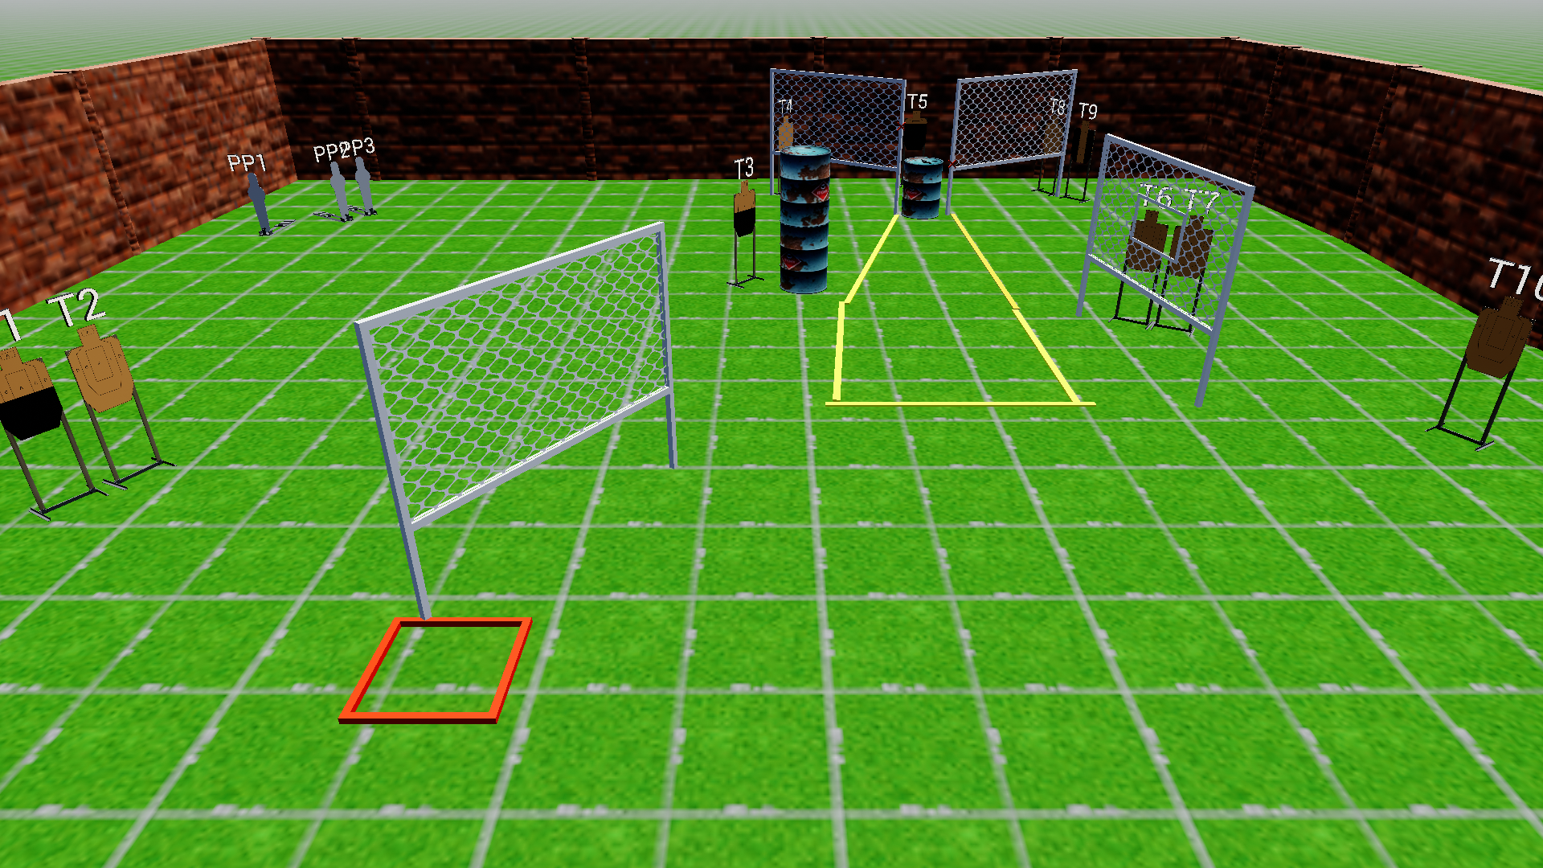
 | Stage 3 A Barrel a Day Course Designer: Jordan Rogers

